Slide 1

Control Software For A Flight Simulator Experience
Omar Maaouane Veiga
PDE3823 Major Project and Professional Practice

Slide 2
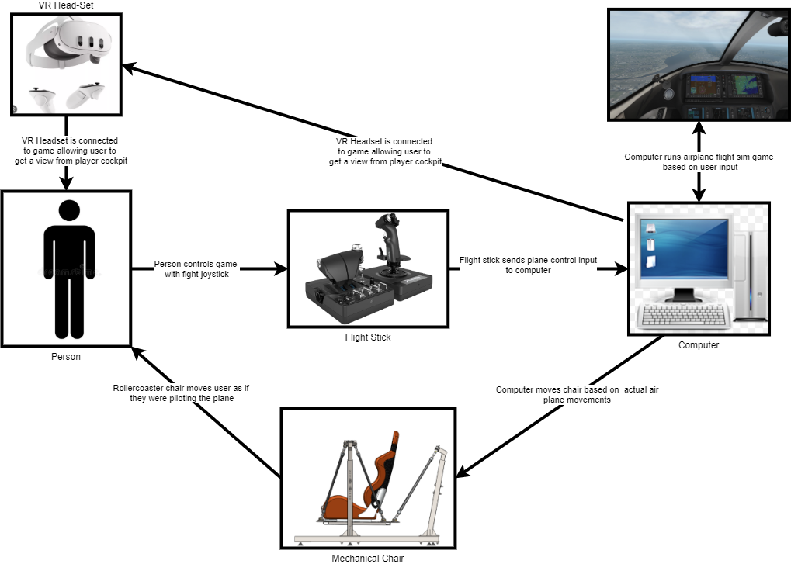
Introduction
The core goal of this project is to provide a comprehensive set of ready to use software that allows the MDX mechanical chair platform to simulate the motions of an airplane on a flight simulator

Slide 3
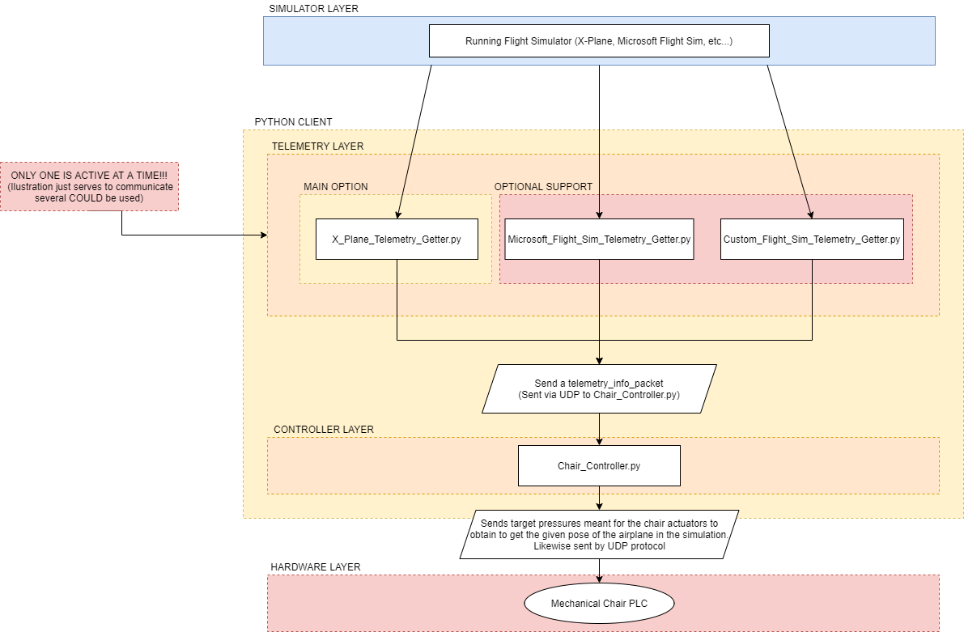
Aims and Objectives
The software aims to provide an operator a control app to manage the chair’s operation

Slide 4
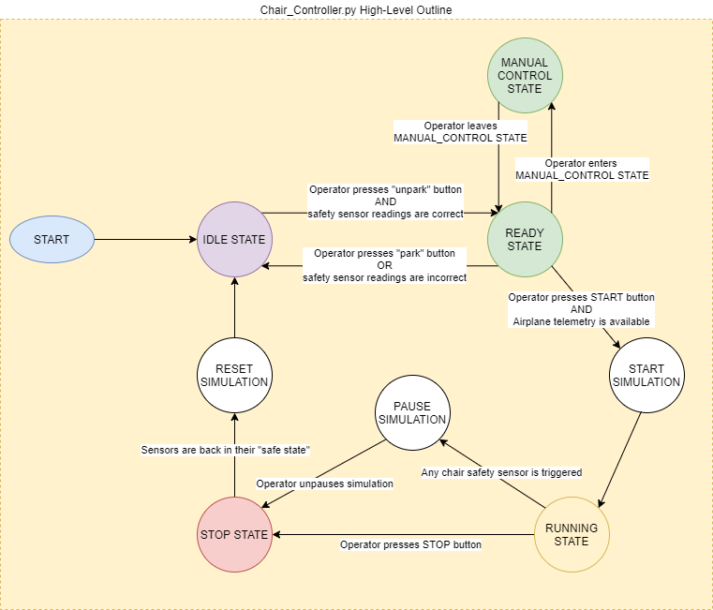
Software Functionality
The software will aim to provide the functionality described in this state machine diagram

Slide 5
Lit review and Background
Due to project complexity, this project relied on a lot of pre-existing code. X-Plane is the main simulator of choice for the project
The two main code libraries are Xpython (X-Plane telemetry) and SimOpConsole repo (platform control modules)
Some other code libraries used were Stewart_Py (python platform display) and PyQt (GUI development)
Research on how existing flightsims simulate movement was also done (included in appendix)

Slide 6
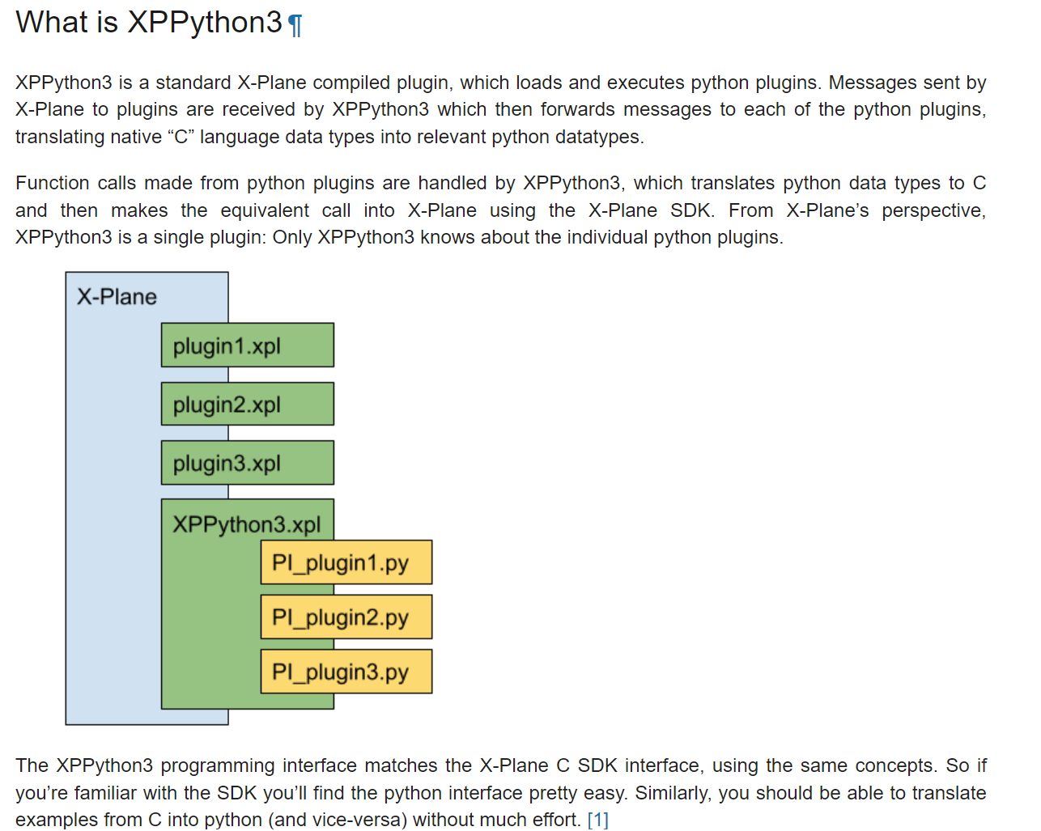
Some Of The Used Codebases

Slide 7
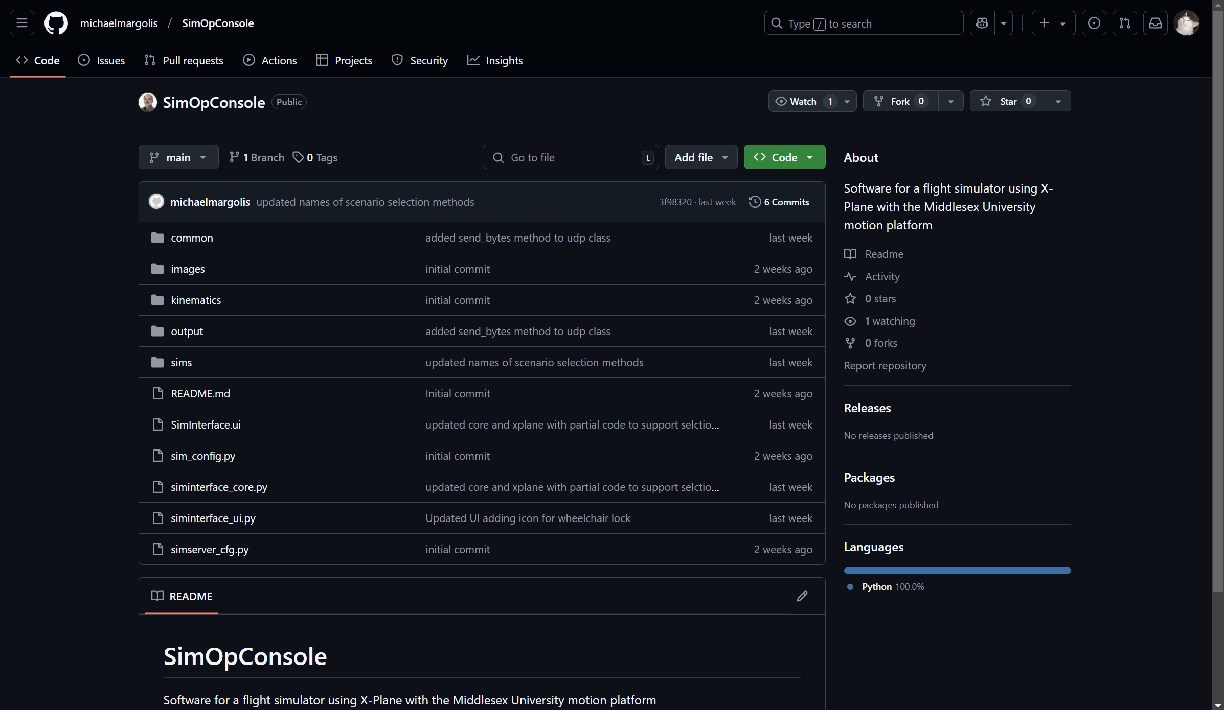
Some Of The Used Codebases

Slide 8
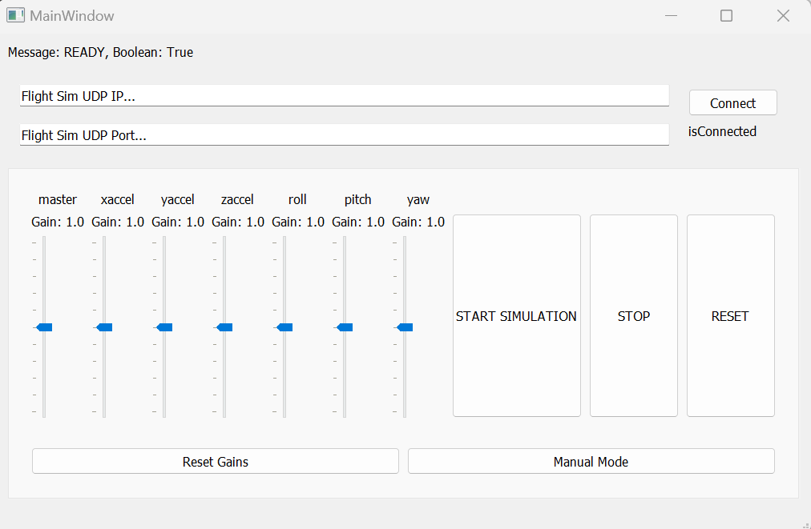
Some Of The Used Codebases

Slide 9
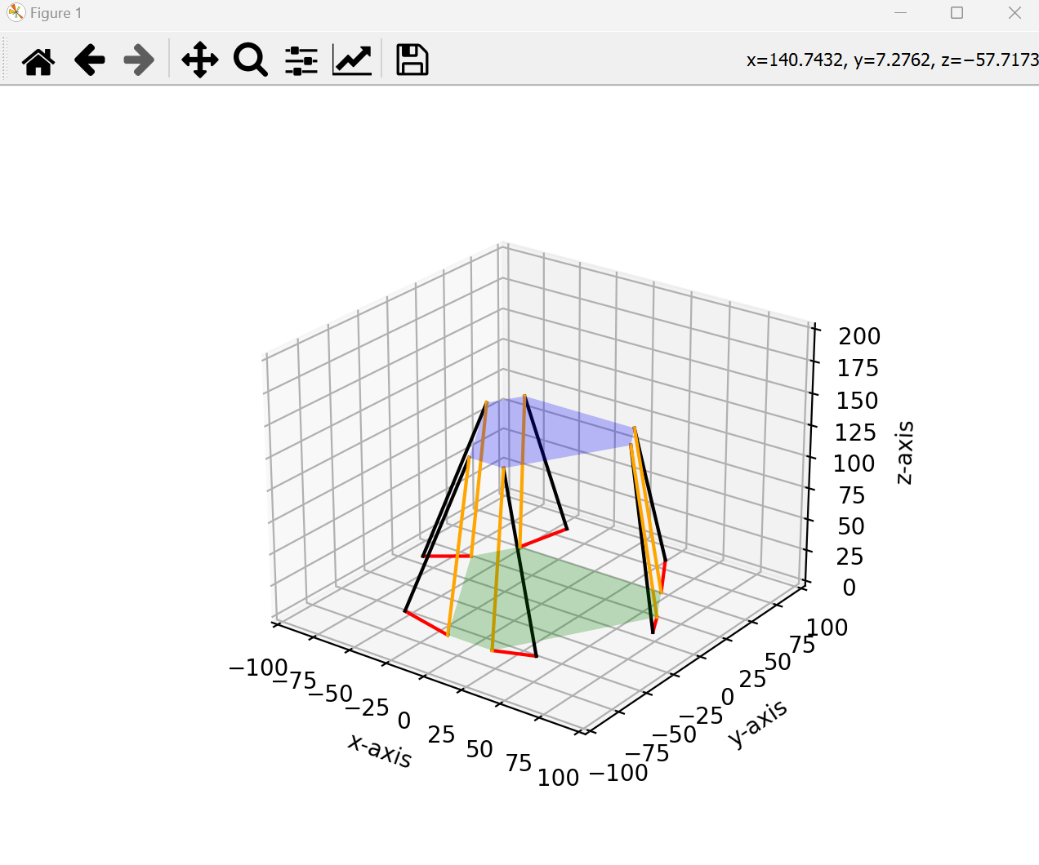
Some Of The Used Codebases

Slide 10
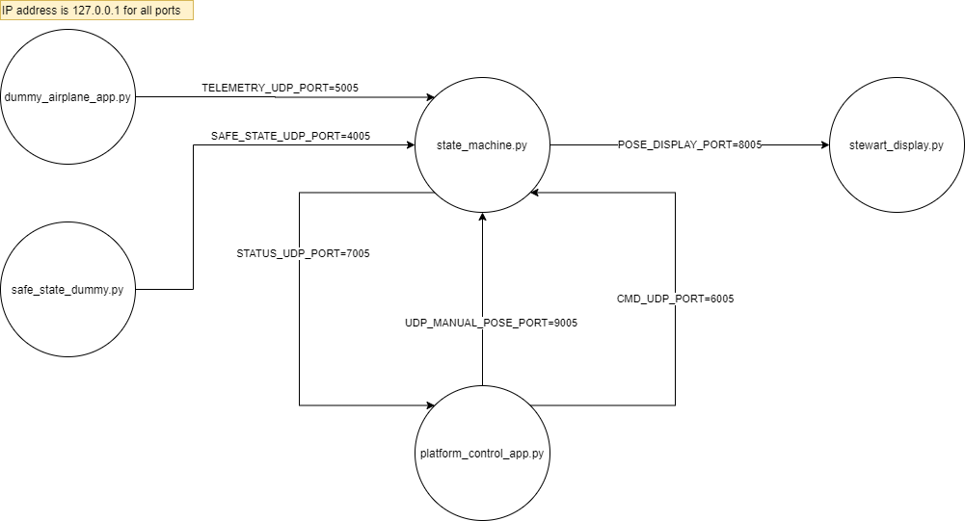
Methodology For Control Software
The control software was designed to be a network of nodes where each does a specific task. All communication between nodes is done via UDP protocol

Slide 11
System Design And Implementation
The first step was to create a skeletal system for the proposed node network, including the state machine that enables the operator to robustly control the chair’s operational modes as needed
After that, developing the GUI control app, designing the display module, and replacing the dummy airplane app with the real simulator naturally followed from the skeletal system

Slide 12
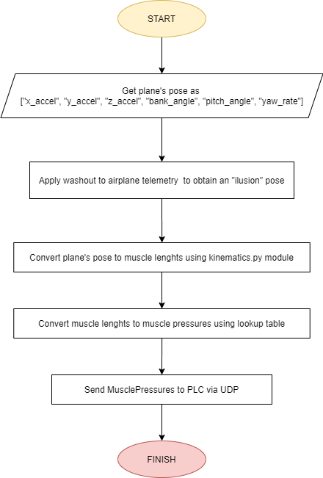
System Design And Implementation - Dynamics
Another key detail regarding the dynamics of the chair is how the fluidic muscle pressures are obtained from the X-Plane pose
As of Week-6, chair can be moved according to X-Plane flight-sim telemetry using the inverse kinematics module (video next slide)
Ignore “washout” application and those filters are yet to be implemented

Slide 13
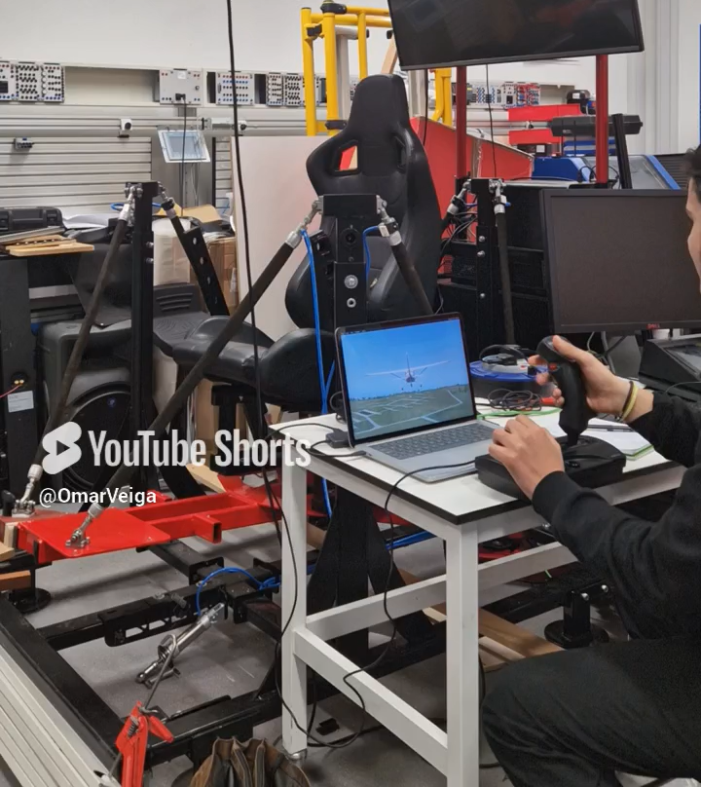
Progress So Far Video

Slide 14
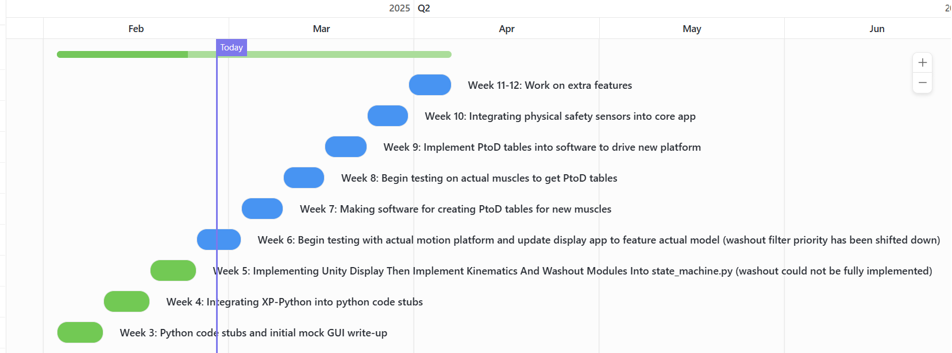
Conclusion And Future Work
So far, the physical chair can be moved according to the simulated airplane’s movements using pre-existing IK modules. Next steps are shown in gantt chart

Slide 15
Thank you!
Technical Presentation
By: Omar Maaouane Veiga
PDE3823 Major Project and Professional Practice

Slide 16
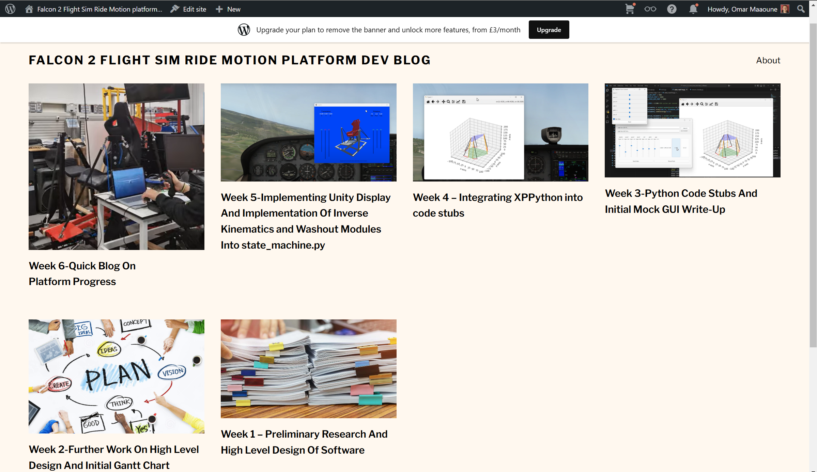
Appendix
All the appendix information can be referred within project blog (here):
https://flightsimmotionplatformproject.wordpress.com/

